Slide 1
I just met you, and 'this' is crazy, but here's my NaN, so call(me) maybe?
JavaScript is so weird

Slide 2
What makes JavaScript fun? (and by fun I mean....a little bit strange)
JavaScript
Blocks
Functions
Null
Equality
Truthy/Falsey
Objects
this!
Eval
parseInt
NaN
With
JSLint/JSHint
Arrays
Switches
more...

Slide 3
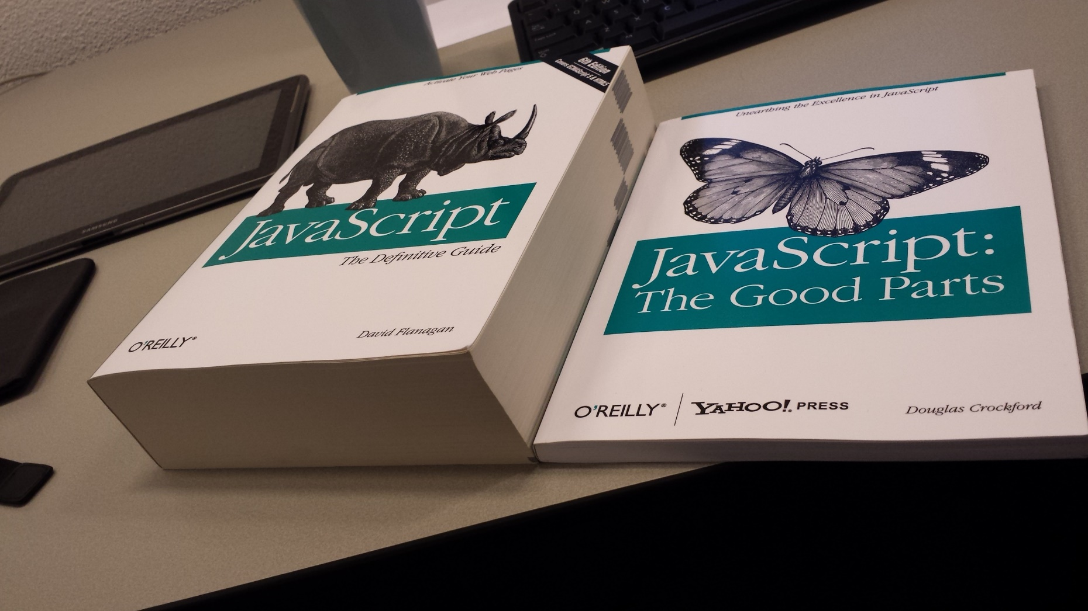
http://i.imgur.com/wR3ZxfB.jpg
Notes:
Image Source http://i.imgur.com/wR3ZxfB.jpg

Slide 4
JavaScript
...is not Java
Java is to JavaScript as car is to carpet
Java is to JavaScript as ham is to hamster

Slide 5
Syntax Error
Automatic semicolon silliness
{}
;

Slide 6
Syntax Error
Most often, a newline (\n) ends a statement unless...
The statement has an unclosed parenthesis ")", array literal, or object literal.
The line uses -- or ++
Any block statements such as for, while, do, if, or else, and there is no starting bracket "{"
After these constructs: break, continue, return, throw

Slide 7
Just say no to single line blocks
One single line
if (ok)
x = true;
Can turn into
if (ok)
x = true;
callFunc();
Then looks like
if (ok)
x = true;
callFunc();
In reality it is
if (ok) {
x = true;
}
callFunc();

Slide 8
Putting the "fun" in functions
function functionStatement() {
// Some code
return value;
}
var functionExpression = function() {
// Some code
return value;
};
Notes:
Sometimes JS treats a function like a value and sometimes it treats it as an executable block of code. This is why we have both functions statement and function expression. Let's dig into each:
-The function statement
Syntactically the function statement starts with the function keyword then names the function end encloses the function contents with brackets.
Use a function statement to declare a function that you will use later. The code in between the brackets will not execute until the function is called from somewhere else. Inside of a function statement we use the return keyword to return a value to the calling code. Functions statements load at parse time before any code is executed.
Function expressions, on the other hand, loads when the interpreter reaches that line of code. – that means they load at runtime.
So if you try to call a function expression before it's loaded, you'll get an error. But if you call a function declaration, it'll always work. Because no code can be called until all declarations are loaded.

Slide 9
Putting the "fun" in functions
(function () {
console.log("anonymous function");
})();
(function IIFE() {
console.log("function expression");
})();
Notes:
Function expressions run immediately, and when they do it's called an IIFE or Immediately-Invoked Function Expression
An Immediately-Invoked Function Expression is the only function that you can't call, it simply executes on the spot as the interpreter hits its location in code.
What makes the function execute immediately is the syntactic location of empty parenthesis just after the function's closing curly bracket.

Slide 10
Putting the "fun" in functions
function main() {
var x = functionStatement();
function functionStatement() { ... }
var functionExpression = function() { ... }
functionExpression();
}
Notes:
You have flexibility in choosing the calling syntax, depending on whether or not you plan on using the return value. Regardless, it is the loading behavior that is more important than the syntax. In the on screen sample, we see how the code will work, but we should investigate the mechanics of how function statements and expressions work. [demo]

Slide 11
DEMO
Fun with functions
Notes:
Let's see JavaScript run some functions and determine the difference in loading between statements and expressions.
As you can see here in the demo, we have a web page in IE on the left and the IE debug tools on the right.
The developer tools show an html page containing a single button that runs some script.
In its corresponding JS file we see the declarations for all 3 function types starting with a
function statement the top of the file that returns a string into a variable named "s" in the calling code.
The function expression does the same by returning a string with the value "function expression" in it, and it returns that value into a variable named "e". In this case we are using both the function statement and expression the same way.
These two functions sit alongside an IIFE, which does not return any value as its job is to run the code immediately.
let's create a breakpoint, and see these dynamics in action. But before we do, let's take note that the call to the function expression happens before its location so that should error. I'll hit F5 now.
As you can see, the code doesn't even make it to the break point.
The function statement runs as you'd expect. The expression does not. This is because its trying to call the function expression before it loads, and expressions load where they are located in code – so it's not loaded yet.
If we swap the call and declaration of the function expression, then it should work.
Let's try running the code again.
We see it makes it to the breakpoint, so we know the expression has worked. Let's continue running and take a look at the IE output console, we can see that all three functions run, including the IIFE that ran with no need to call it.

Slide 12
Arrays
There is no such thing
No dimensions
No out of bounds errors
typeof doesn't know the difference
Notes:
Arrays in JS aren't real arrays, they're phony
no dimenstions
no out of bounds errors

Slide 13
Carry on
continue statement
"I've never seen a piece of code that was not improved by removing it"
-- Crockford

Slide 14
The switch
Auto fallthrough
switch (expression) {
case expression:
statements
[break;]
case expression:
statements
[break;]
default:
statements
[break;]
}

Slide 15
Let's get to the truth of the matter
Truthy values
'false' (quoted false)
'0' (quoted zero)
() (empty functions)
[] (empty arrays)
{} (empty objects)
All other values
Falsey values
false
0 (zero)
'' (empty string)
null
undefined
NaN
Notes:
What constitutes something falsy in JS?
false.
0 (zero)
"" (empty string)
null
undefined
NaN (a special Number value meaning "Not a Number")
All other values are truthy, including "0" (zero in quotes), "false" (false in quotes), empty functions, empty arrays, and empty objects.
Falsey:
false
0 (zero)
"" (empty string)
null
undefined
NaN
Truthy
"false" (false in quotes)
"0" (zero in quotes)
() (empty functions)
[] (empty arrays)
{} (empty objects)
All other values

Slide 16
Let's get to the truth of the matter
"0"
false
""
"false"
Null
NaN
Function
undefined
{}
[]
0
Notes:
What constitutes something falsy in JS?
false.
0 (zero)
"" (empty string)
null
undefined
NaN (a special Number value meaning "Not a Number")
All other values are truthy, including "0" (zero in quotes), "false" (false in quotes), empty functions, empty arrays, and empty objects.

Slide 17
All things being equal-ish. Maybe.
==
===
!=
!==
Notes:
JavaScript has two sets of equality operators, equal to (==) and exactly equal to (===) and their counterparts in negation (!= and !==). The exactly equals works the way you expect. If the two operands are of the same type and have the same value, then exactly equals produces true and its negative partner (!==) produces false. The plain equals, OTOH, see different data types and attempts to coerce the values (it's called type coercion) by using a set of many overly complex rules.
It's just not reasonable to memorize all these rules, especially if you are trying to create team standards from them. Therefore, since it's more accurate going with the exactly equals is the best option.
Let's see some of this JS equality or non equality as the case may be, in action...[demo]
THE TAKE AWAY: Use the === and !== opeartors as they give consistent and accurate results, more closely to what you might expect.
console.log(0 == '');
console.log(0 === '');
console.log(0 == '0');
console.log(0 === '0');
console.log(false == 'false');
console.log(false === 'false');
console.log(false == '0');
console.log(false === '0');
console.log(false == undefined);
console.log(false === undefined);
console.log(false == null);
console.log(false === null);
console.log(null == undefined);
console.log(null === undefined);
console.log('\t\r\n' == 0);
console.log('\t\r\n' === 0);

Slide 18
DEMO
Truthy and Falsey
Notes:
Let's look at how JavaScript compares some values with both the standard equality operator and the exactly equals operator.
I'll paste in some expressions that log their output
First, does 0 == '' (zero = empty string). The equality operator says yes and exactly equals says no. **
0 == '0' // true (zero and quoted zero, that's ) Again, The equality operator says yes and exactly equals says no.
false == 'false' // false (does false = a quoted false) That's a result of false on both lines of code,
false == '0' // true (does false = quoted zero) That's conflicting results between the operators
false == undefined is in agreement between them as is false == null
But null == undefined is true for equals but false for exactly equals, and the oddest of all, ' \t\r\n ' == 0 // true (tab, carriage return, new line) DOES equal zero, sometimes. But not really.
(reverse operands and try ===) **

Slide 19
Just what's up with this, anyway?
Notes:
Many folks try to treat "this" the same way that it works in other languages and their notion of this is normally static and at the class level. JavaScript is different though, as this works based on the context of the calling code.
Usually this belongs to the window, or global object, but it can also be the HTML element that has caused an event, for example, a button causing a click event. Then the function is owned by that source element and that element becomes this.
To go a little deeper
JavaScript functions run in an execution context that goes on the stack. The stack is an in memory storage location for variables and data.
Functions are also values, and they're treated like objects/values.
What this means is that each time another function runs, it gets pushed onto the stack and the context for "this" changes. That's unlike other languages where this is usually clearly defined.
So the value of this depends on 2 things: What kind of code is executing? (global, function, or eval) and the calling code.
*******
ES5 introduces the a way that you can set the value of "this" in a function, as the first argument of the call.
Here in the IE console we have a function called saySomething that accepts a string and logs both this and the string to form a sentence about what this . Let's see it work.
Now that I've run the function I can call it and make 'this' a programmer or a trekkie or katniss everdeen. Not that you'd wants strings to be this bit
function saySomething(thing) {
console.log(this + " says " + thing);
}
saySomething.call("A programmer", "Hello world");
saySomething.call("A Trekkie", "Live long and prosper.");
saySomething.call("Katniss Everdeen", "May the odds be ever in your favor");
saySomething.call("A ghost", "Boooooooo!");

Slide 20
Or just a lowly, misunderstood, function?
Eval - the most evil of all?
var x = eval("forms[0].option" + optionNumber + ".checked");
var x = forms[0]["option" + optionNumber].checked;
Notes:
JavaScript contains a function named eval that allows you to run dynamic snippets of code. While this sounds like a great idea, it can introduce some nasty security bugs, as malicious users can try to insert and run malicious code.
The thing is - there's usually a better, clearer, and easier way than resorting to eval. When folks use eval it is usually because they are unaware that there is a perfectly fine alternative in JS already.
For example, something like this (1st bullet) where eval ties a dropdown's option to
Since you're executing dynamic code created at runtime, it's going to be slower than regular JS parsing.
Debugging is a challenge
Most often, programmers use eval to parse string numerals to array subscripts
--Can be changed to—
function isChecked(optionNumber) } var result = isChecked(1);
FRIENDS OF EVAL – settimeout new function

Slide 21
Are you with me, or against me?
with (objX) {
// statements
}
Notes:
Just like in VB, JS has a with statement. This statement allows you to block off some code to work directly with variables using a shortened syntax. While this seems like a feature it usually ends up confusing developer rather than helping. For one, it's sporadic and inconsistent usage makes it difficult as it rarely adheres to any company or teams coding standards.

Slide 22
New, new, don't do
typed wrappers
new object
new array
new Date

Slide 23
farceInt(fib);
static int parseInt(String s)
static int parseInt(String s, int radix)
Notes:
parseInt is a function that accepts a string and parses it to ensure it is an integer. It has two method signatures, one which accepts only the string to convert, and the next accepts a string and a radix, or base, such as base 2, or base 10. Most software runs perfectly fine in base 10 systems and we normally don't need to specify that as the default. However, parseInt doesn't rely on what the system defaults are to perform its duty. Rather, parseInt assumes the radix based on the following rules: [next slide]

Slide 24
parseInt's farce parsing
0X or 0x
16 (hexadecimal)
0
10 (decimal)
8 (octal)
Everything else
10 (decimal)
var result = parseInt(numericString, 10);
Notes:
If the input string begins with "0x" or "0X", radix is 16 (hexadecimal) and the remainder of the string is parsed.
If the input string begins with "0", the radix could be octal or decimal. The radix that parseInt uses is dependent on external factors like whether or not the browser supports it based on its ES5 implementation.
If the input string begins with any other value, the radix is 10 (decimal).
Your choice is to try to memorize all these facts or, just make it a rule that you specify a radix when using parseInt. The syntax will look something like this [show sample] It seems the latter is far easier to remember, code, and maintain.
As an example of parseInt's craziness, let's examine a sample from the Mozilla Developer center of 15 different calls
https://developer.mozilla.org/en-US/docs/Web/JavaScript/Reference/Global_Objects/parseInt
parseInt("2A",16);
parseInt("2A", 8);
---
parseInt("2A",16); // 42
parseInt("2A", 10); // 2
parseInt("2A", 8); // 2
parseInt(42.99, 10); // 42
---
from Mozilla
parseInt(" 0xF", 16);
parseInt(" F", 16);
parseInt("17", 8);
parseInt(021, 8);
parseInt("015", 10);
parseInt(15.99, 10);
parseInt("FXX123", 16);
parseInt("1111", 2);
parseInt("15*3", 10);
parseInt("15e2", 10);
parseInt("15px", 10);
parseInt("12", 13);
console.log(parseInt(" 0xF", 16));
console.log(parseInt(" F", 16));
console.log(parseInt("17", 8));
console.log(parseInt(021, 8));
console.log(parseInt("015", 10));
console.log(parseInt(15.99, 10));
console.log(parseInt("FXX123", 16));
console.log(parseInt("1111", 2));
console.log(parseInt("15*3", 10));
console.log(parseInt("15e2", 10));
console.log(parseInt("15px", 10));
console.log(parseInt("12", 13));

Slide 25
NaN
It claims it's NotANumber, but it's a number.
Don't use equality operators with NaN
Use Number.isNaN() instead
Use typeof instead
Don't use plain isNaN() – or else nothing is a number!
ES6 Number.isNaN()
Notes:
typeof NaN returns 'number'
the lolz with that one

Slide 26
Seems legit
Is legit
var add = function(where are the arguments?) {
return arguments[0] + arguments[1];
};
console.log(add(4, 4)); // returns 8
var add = function() {
return arguments[0] + arguments[1];
};
console.log(add(4, 4)); // returns 8

Slide 27
How to avoid all the odd stuff
JSLint
JSHint
JSFiddle
Notes:
With all these crazy things that JS does, we need to ensure our code actually works! As you've learned, JS has enough rules that memorizing them is a daunting task. That's no problem though, as we have tools to help us verify (or lint), our code.
JSFiddle – Of course I've been using this throughout the course. JSFiddle as you know is an online playground that lets you work with html, css, and js, of course, all online. What we didn't talk about is that can save code and perform some linting with JSHint to test out again later.
JSLint – This is another online utility by Douglas Crockford (author of a famous JS book called "Javascript The good parts")
JSHint – JSLint is quite sharp and stricts, so JSHint is a lightweight version of JSLint.
Of course if you develop software for a company you might use Visual Studio that has linting options and tools, as well as Jet Brain's editor named Web Storm.
No longer will you be stuck when JavaScript decides to misbehave.
You've learned that Javascript has many quirks from simply annoying to downright nasty. To make sure that JavaScript is used correctly and effectively by your team, balance their styles and skills against the many gotchas you've learned here. Just as well you can use JSLint and JSHint to your advantage to assist you in writing better code!

